Slide 1
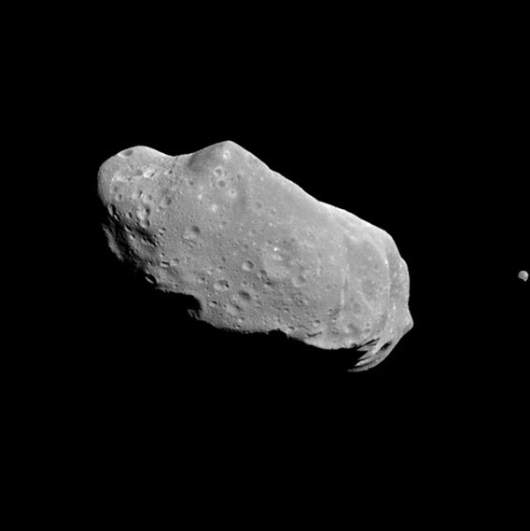
Asteroid Scouting Mission
Notes:
Image Credit: NASA 243 Ida

Slide 2
Mission Overview
Expanding the human presence further out into the solar system is going to take a lot of teamwork and resources.
It is not energy efficient to take these resources off the Earth to deep space for development.
It is too costly to mine materials on Earth, launch these materials, and then build them in space.
Your mission is to navigate your solar sail around a section of the asteroid belt using your magnetometer sensors. Identify key asteroids that would be ideal for mining iron for deep space development.

Slide 3
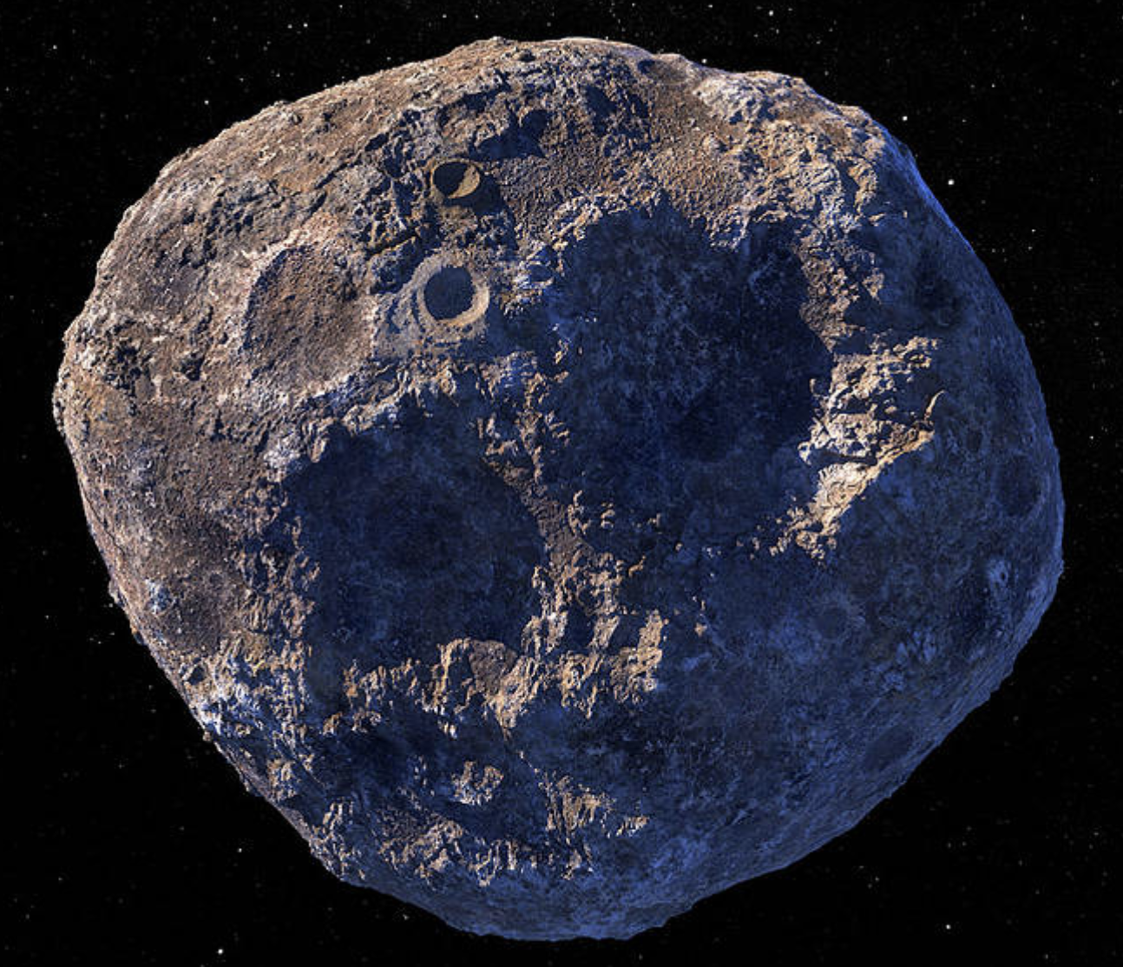
Asteroid Briefing
Asteroids reside between Mars and Jupiter in the asteroid belt.
Rocky, airless remnants left over from the early formation of our solar system about 4.6 billion years ago.
The total mass of all the asteroids combined is less than that of Earth's Moon.
Many of these bodies contain high concentrations of rare metals such as gold, silver, and platinum, iron and nickel in amounts greater than what is on Earth.

Slide 4
Psyche is a metalloid asteroid that is the focus of the Psyche mission, which will launch in October of 2023
Psyche is believed to be the partial remains of a planetary core
First world to be explored that is made of metal

Slide 5
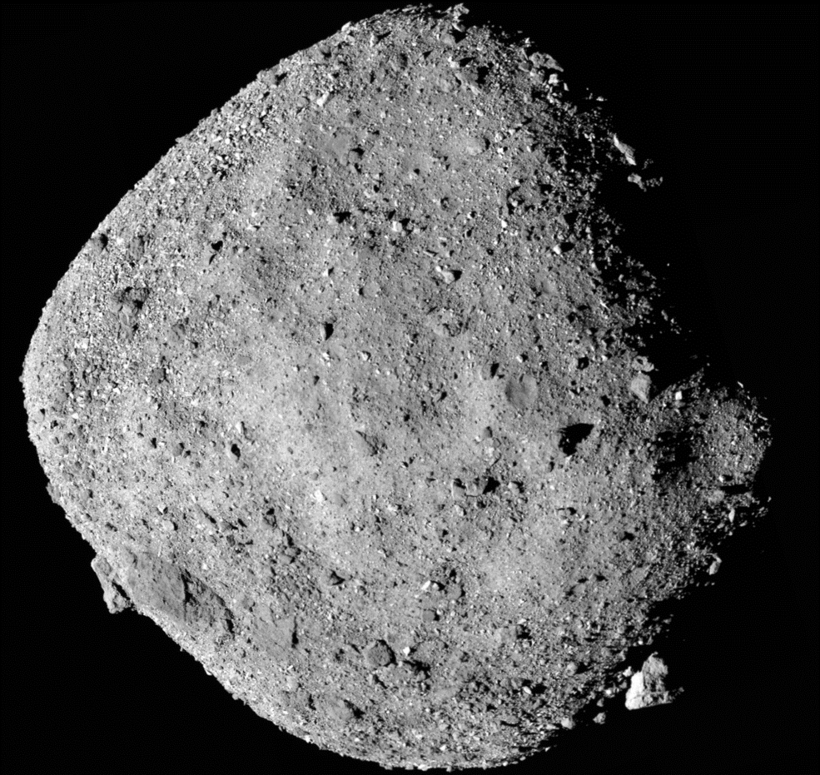
OSIRIS-REx Sample Return Mission
Launched in September 2016
First U.S. mission to collect a sample from an asteroid
Successfully obtained a sample from asteroid Bennu in October 2020
Sample capsule to be delivered to Earth in September 2023
Extended mission to Apophis in 2029
Notes:
https://solarsystem.nasa.gov/missions/osiris-rex/in-depth/#:~:text=After%20orbiting%20the%20Sun%20twice,spacecraft%20and%20enter%20Earth's%20atmosphere.https://solarsystem.nasa.gov/missions/osiris-rex/in-depth/#:~:text=After%20orbiting%20the%20Sun%20twice,spacecraft%20and%20enter%20Earth's%20atmosphere.

Slide 7
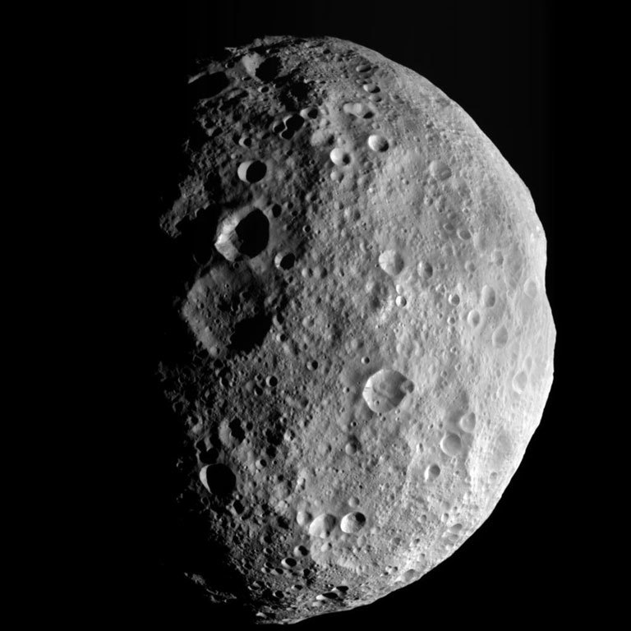
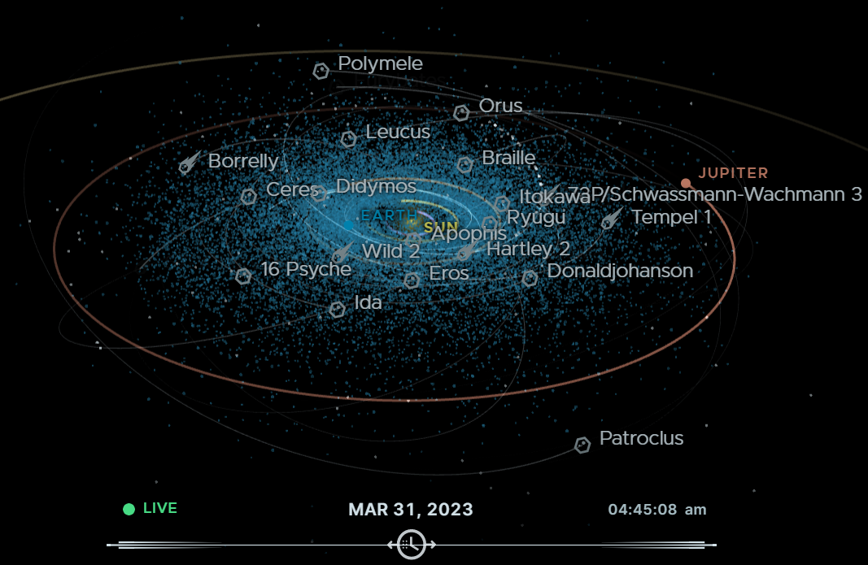
NASA Eyes on Asteroids
Notes:
https://eyes.nasa.gov/apps/asteroids/#/asteroids/

Slide 8
Mission Planning
Earth Observations
Space Observations
Flyby
Lander
Robots
Sample Return
Humans

Slide 9
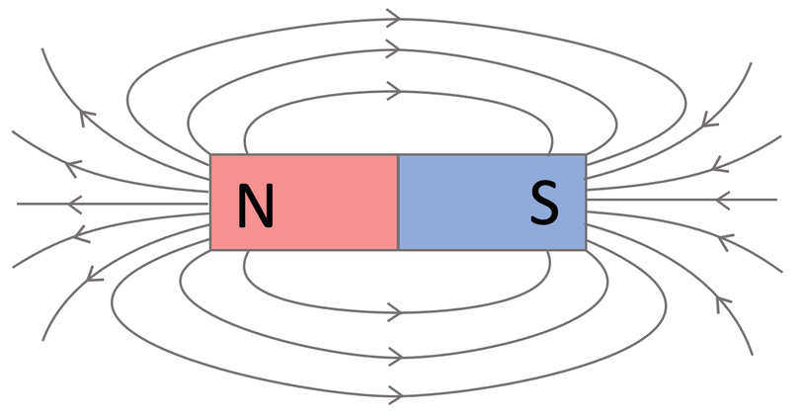
Magnets
Magnetism is the force exerted by magnets when they attract or repel each other. Magnetism is caused by the motion of electric charges.
A magnet is anything that produces a magnetic field.
A material that is magnetic is capable of either being magnetized or being attracted by a magnet. These types of materials include iron, nickel, cobalt and their alloys, some types of rare-earth metals, and some naturally occurring minerals such as lodestone.
SI unit for measuring magnetic field strength is a Tesla.

Slide 10
Mission Overview
Expanding the human presence further out into the solar system is going to take a lot of resources.
It is not energy efficient to take these resources off the Earth to deep space for development.
It is too costly to mine, launch, and build in space.
Your mission is to navigate your solar sail around a section of the asteroid belt using your magnetometer sensors. Identify key asteroids that would be ideal for mining iron for deep space development.

Slide 11
Asteroid Scouting
Mission Plan
Your mission is to design a spacecraft that will travel through the asteroid belt to identify key asteroids that would be ideal for mining iron for deep space development. Each asteroid has been assigned a value based on the amount of iron and valuable minerals inside. After your scouting mission, you will identify your top three asteroids that you feel should be mined for ore. The team that has the biggest return on investment will win the mission!
Parameters:
Budget: $50,000,000
A PocketLab sensor* must be attached to your spacecraft.
One person from your team will fly the spacecraft to specific asteroids within the belt region.
A Flyby mission planner must have your specific trajectory completed before the mission begins.
The “spacecraft” carrying out this mission cannot change the trajectory after leaving Earth. If they do, they will be fined $10,000,000.
Each second between entering and exiting the asteroid belt costs $1,000,000.
Notes:
*This mission can also be done without a PocketLab sensor. Students can walk their trajectory using rare earth magnets or a compass instead to see which asteroids have the an attraction.

Slide 12
Mission Planning
What are the three different types of asteroids and their characteristics?
Research:
What is an asteroid?
How many currently known asteroids are there?
Where do we find most asteroids?
What is the total mass of all asteroids combined?
1.
2.
3.

Slide 13
Mission Roles
Mission Role | Person Assigned
Project Manager Group leader to ensure goals of the mission are accomplished
Chief Financial Officer Maintains the mission budget
Navigator Determines the asteroid route that the spacecraft should travel during the mission
Timekeeper (different name) Records the time and location of the spacecraft during the mission
Data Scientist Analyzes and reports the magnetic field data to the group in order to identify which asteroid(s) should be targeted for mining

Slide 14
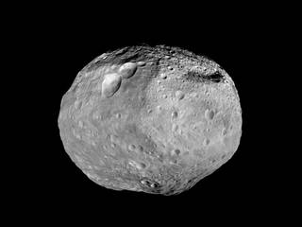
Mission Finances
Scouting
As a team, your group will need to sketch out the asteroid belt and plan a path that your “spacecraft” will take to determine which asteroids may have the most ore. To help with identification, each asteroid has a name in fine print that can only be seen with binoculars from “Earth”. Seeing their names will help your “spacecraft” navigate their pathway through the asteroid belt for a successful mission
The mission team cannot pass the “Earth” line on the floor designated by the mission project manager.
Only the designated “spacecraft” person will be able to leave Earth to fly the planned mission through the asteroid belt.
Using your mission planner, sketch out the asteroid region
For a fee of $5,000,000 you can use the “Telescope” (binoculars) to make observations of the asteroids in your region. You will only have three minutes to utilize the telescope.
Mission Budget
Item​ | Cost
​ | ​
​ | ​
​ | ​
Mission Total​

Slide 15
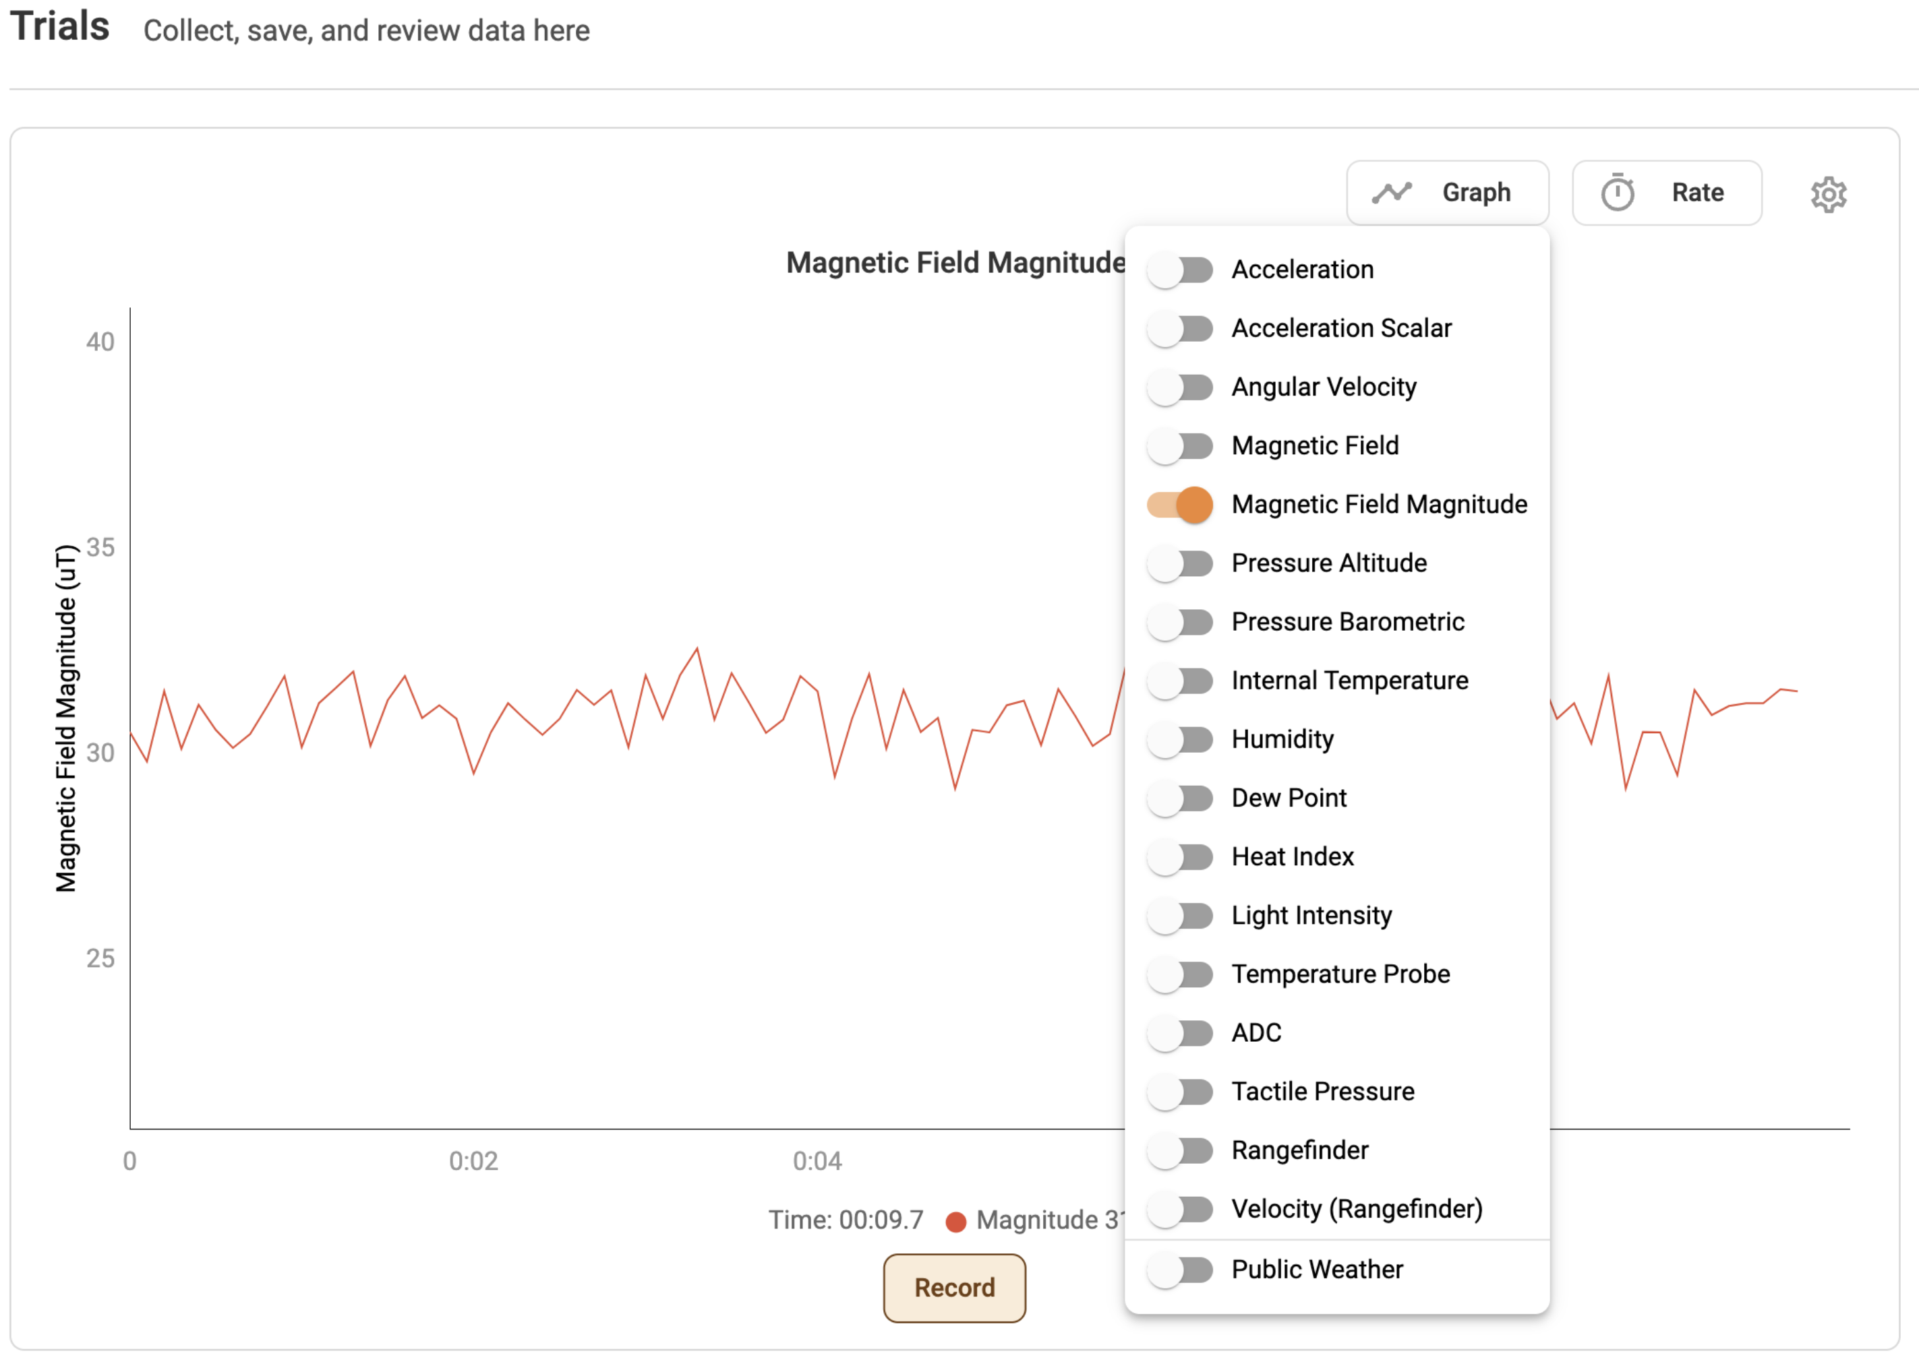
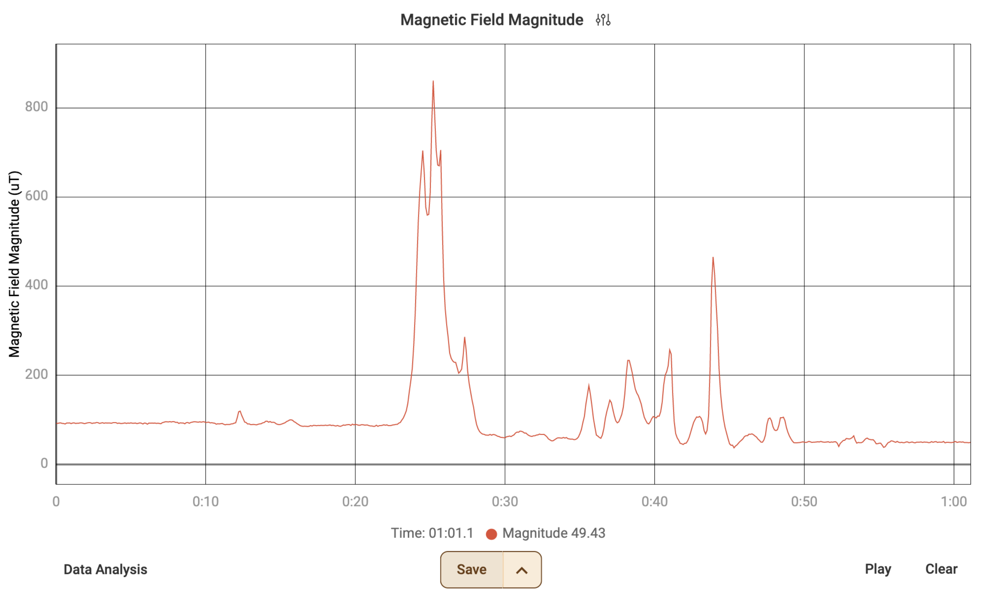
Mission Technology
PocketLab
To use your PocketLab Sensor push the button on top to turn it on. When the light is blinking you will know that it is on.
Click “Connect A PocketLab” and select the correct device.
Click on the “Graph” button in the top right-hand corner. Turn off “Acceleration” and turn on “Magnetic Field Magnitude”.
Click record when you are ready to acquire data.

Slide 16
Mission Planning
Plan your trajectory
In the space below, sketch out the asteroid belt that you see and plan a path for your ”spacecraft” to survey using the Magnetic Field Magnitude sensor. Once your path is set, you cannot change it once your spacecraft has entered the asteroid belt. However, you can take data notes on it during the mission.

Slide 17
Data Recording
Flight Path Data
In the chart below, record the asteroid name, time you surveyed the asteroid, and the magnetic field reading. These units are measured in µT which stands for micro tesla. A Tesla is the SI unit used to measure the strength of magnetic fields.
Asteroid Name | Time Stamp at Asteroid (Seconds) | Magnetic Field Reading (µT)

Slide 18
Mission Review
Asteroid Mission Selection
Now that your mission is complete, rate your top three targets for asteroid mining and give a detailed answer why using the data you acquired during the mission.
Asteroid 1 | Asteroid 2 | Asteroid 3
Claim, Evidence, Reasoning: | Claim, Evidence, Reasoning: | Claim, Evidence, Reasoning:
Actual Value: | Actual Value: | Actual Value:

Slide 19
Mission Report
Final Report to the Project Manager
In the space below, complete your budget report and in paragraph form, summarize what you learned about the following during your mission:
Teamwork
Communication
Mission planning
Magnets
Managing finances
Mission Report:
Mission Expenses
Cost to Mine and Refine | $500,000,000
Total Expenses
Highest Asteroid Value​ | ​
Subtract Total Expenses. -
Estimated Net Profit​ | ​

Slide 20
Educator Information

Slide 21
Materials
Binoculars *You can find cheap ones on Amazon or you can allow students to use the zoom feature on tablets or phones.
Consumable materials to build solar sails. (Paper, foil, straws, popsicle sticks, other materials)
Optional Materials
PocketLab or other digital sensors to measure the magnetic forces. This is a great way to have students acquire and analyze data.
Computers with access to PocketLab software (free).
Compass. If you do not have access to Pocketlab Sensors, a compass is a great indicator for magnetic fields that can be used in the activity.
Required Materials
You will need a large space to set up the asteroid field. Your classroom desks may need to be rearranged or an alternative space secured
Foil
Fishing line
Rare earth magnets. There are lots of different shapes and sizes on Amazon that are cheap. The cube or cylinder magnets work well as they are easier to grip when setting them up.
Blue painters tape or something to mark out an area on the floor that designates where the students can't cross into the asteroid field.

Slide 22
Asteroid Scouting Mission Lesson Plan
Grade Level – 4th – 12th Grade
Time – Multiple class periods. Approximately 90 minutes – two hours
Learning Objectives
Students will design and build their own solar sails with PocketLab sensors or a compass to identify magnetic fields.
Students will work as a team to be able to plan and implement a Flyby mission planner to complete a specific trajectory within the asteroid belt region.
Students will be able to analyze their data from the asteroid flyby to identify the top three asteroids that they feel should be mined for ore based on the amount of valuable minerals (magnets) inside.
Students will be able to calculate the return on investment for their asteroid mining mission.
Background knowledge:
The asteroid belt is a region of space located between the orbits of Mars and Jupiter. It is home to millions of asteroids, which are rocky or metallic bodies that range in size from a few meters to hundreds of kilometers in diameter.
Asteroids are thought to be remnants of the early solar system formation. They are believed to have formed when a protoplanet, which was a large body of material that was orbiting the Sun, broke apart.
Asteroids contain a variety of minerals, including iron, nickel, platinum, and gold. Some asteroids also contain water and other volatile compounds.
Asteroid mining is the proposed process of extracting raw materials from asteroids. Asteroid mining is still in its early stages of development, but there are a number of companies and organizations that are working to make it a reality.
There are a number of challenges that need to be overcome before asteroid mining can become a commercial venture. One challenge is the high cost of space travel. Another challenge is the development of technologies to extract and process raw materials in space.
Despite the challenges, asteroid mining has the potential to revolutionize the way we obtain resources. Asteroids contain a vast amount of valuable minerals, and they could be a source of resources for deep space exploration and colonization.
Potential benefits of asteroid mining:
It could provide a source of resources for deep space exploration and colonization.
It could reduce our reliance on Earth-based resources.
It could create new jobs and industries.
It could help us to learn more about the early solar system.
Potential risks associated with asteroid mining:
It could damage the environment on Earth if asteroids are mined in a way that releases harmful materials into space.
It could lead to conflict between nations or corporations over the ownership of asteroid resources.
It could increase the risk of asteroids colliding with Earth if mining operations disturb asteroids.

Slide 23
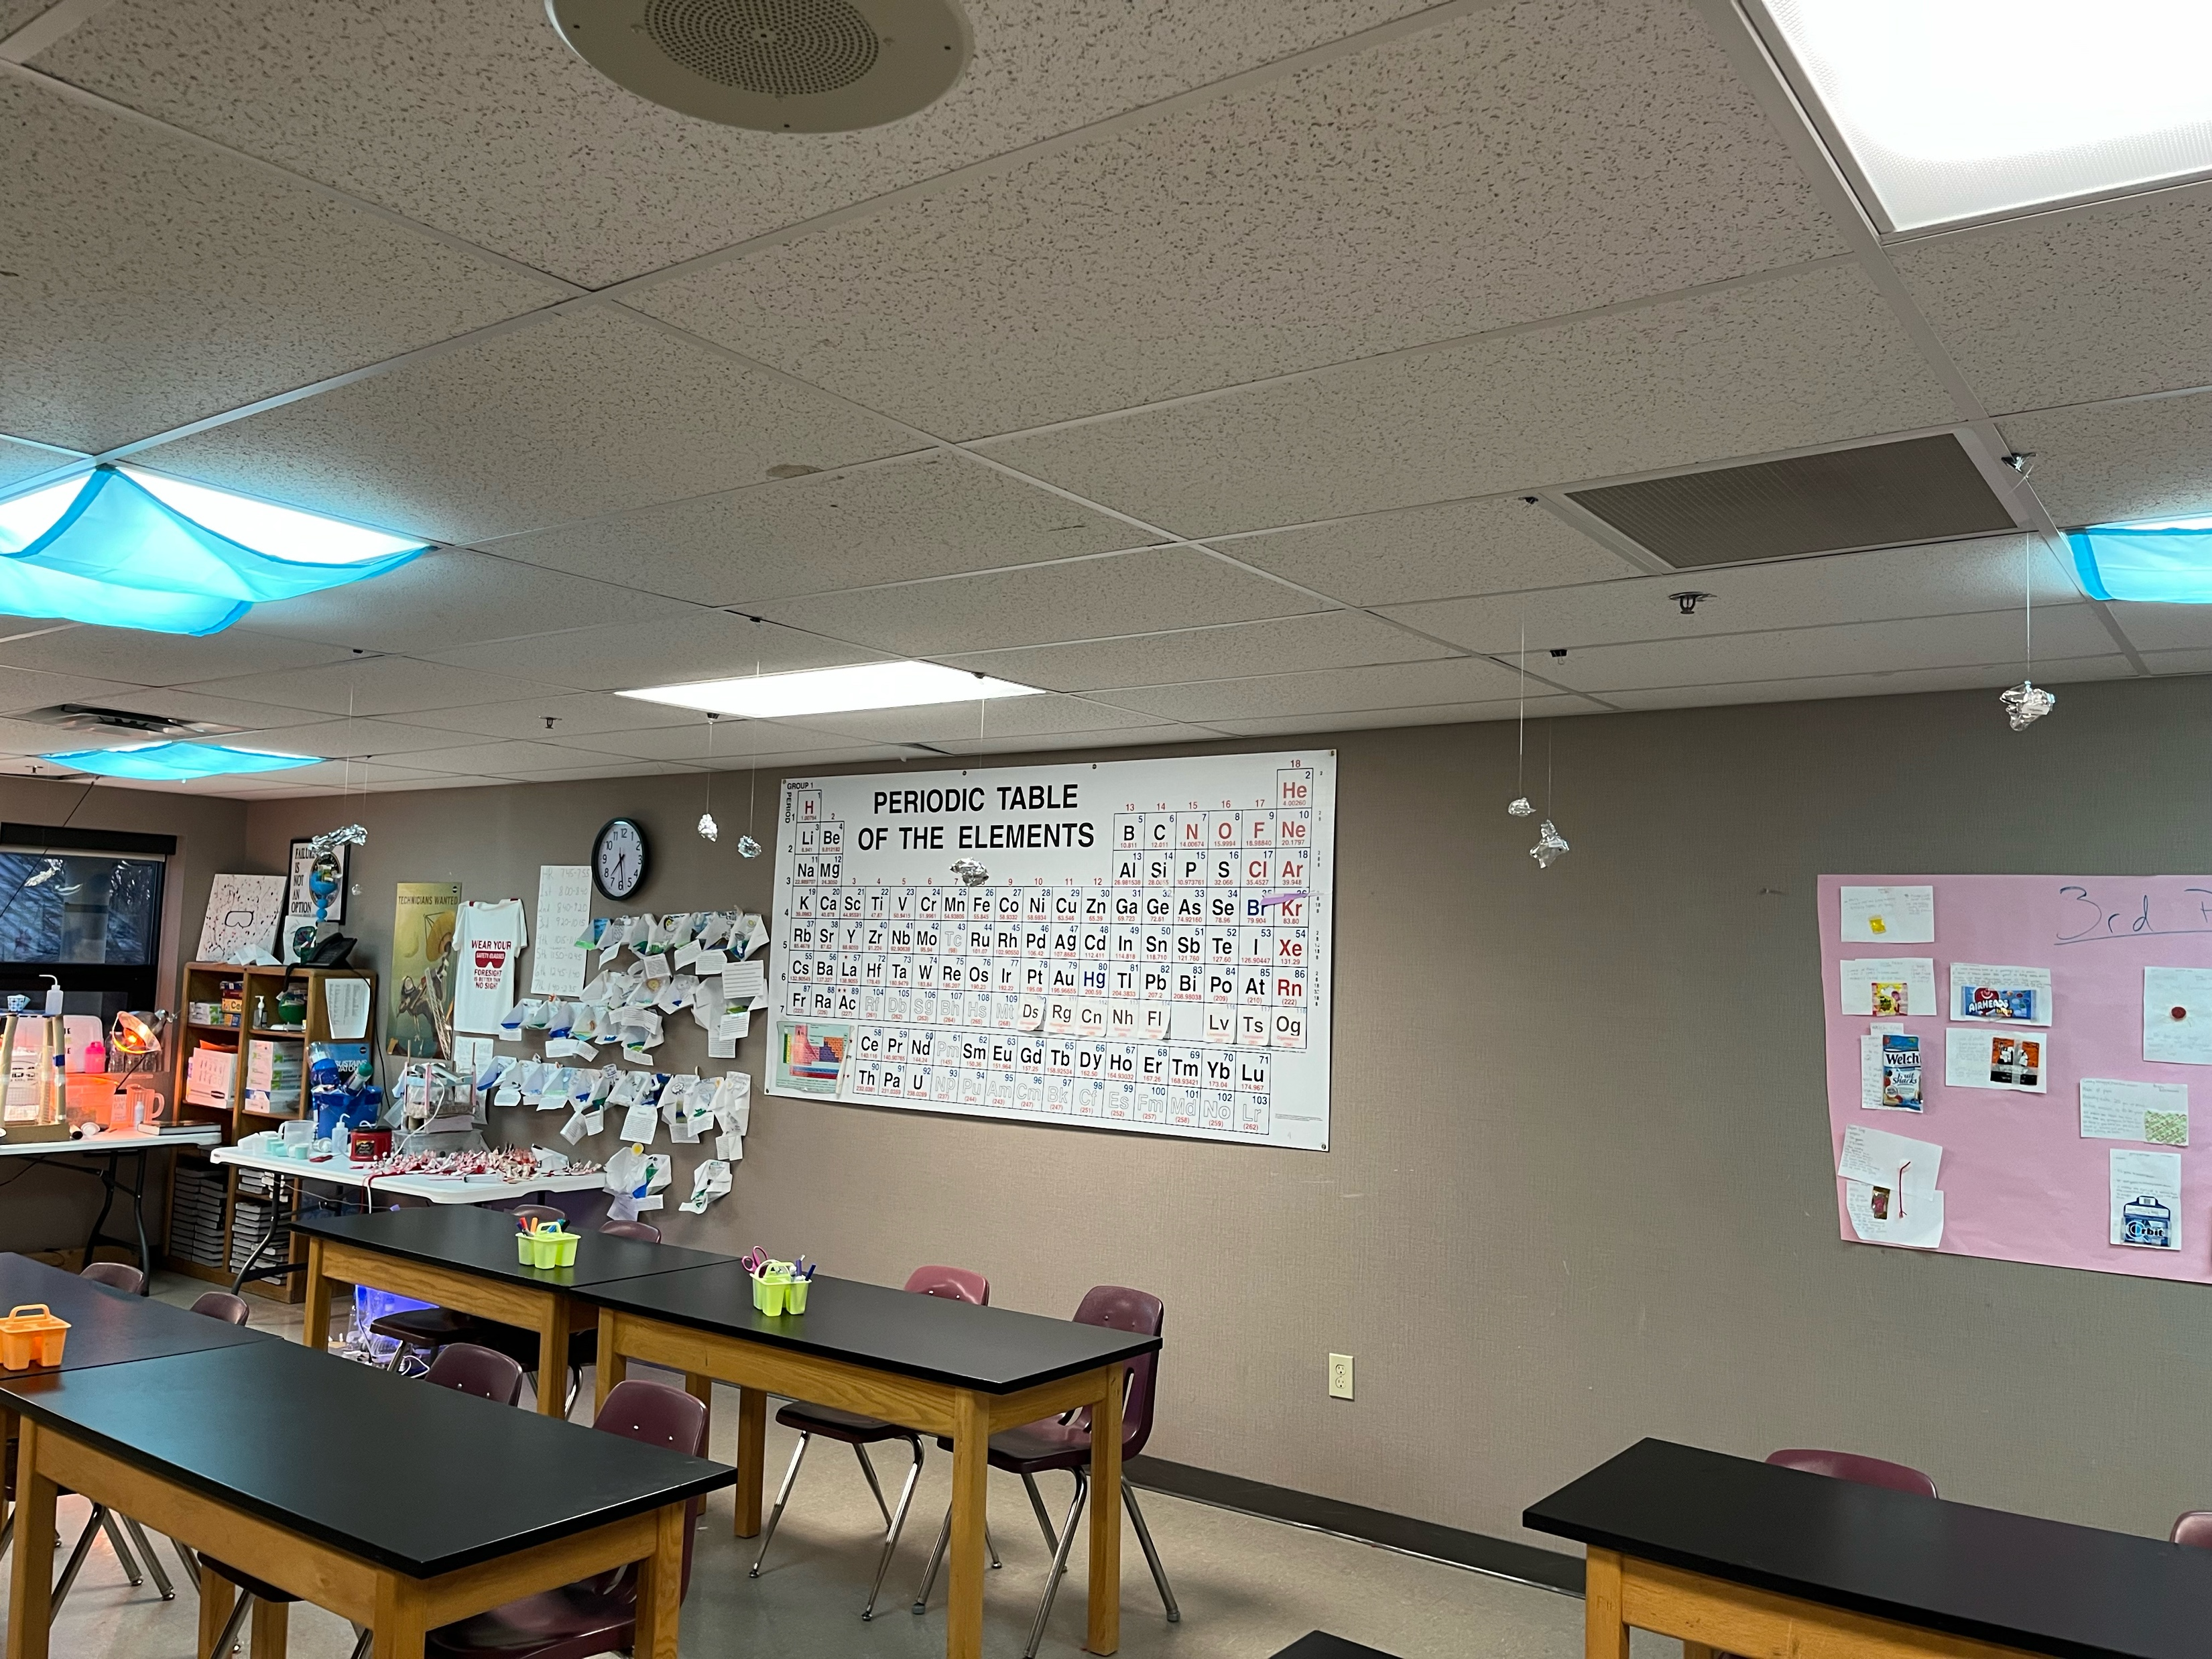
Classroom & Asteroid Setup
This activity does take a little time to prep as the asteroids must be prepped with or without magnets.
It is more fun to do a little research on the asteroids to see which ones are metalloids to make the scenario as realistic as possible. Eyes on Asteroids is a fun and free way to explore various asteroids. The more metal that is predicted to be in the asteroid, the more magnets can be added inside the foil. For example, Psyche always has the most magnets when the field is being prepped.
After the magnets are designated for each asteroid, it can be easy to tape one end of the fishing line to the magnets. Sometimes the line slips out of the tape so adjust as needed.
Wad foil around the magnets and fishing line in any shape you want. Again, it can be more fun if they look like the actual asteroids. Feel free to take creative liberties. If you are not able to hang them from the ceiling you can tape the magnets inside a small dixie cup or just wad them in foil.
If you are able to hang these from the ceiling, one method is to tie the other end of the fishing line to a binder clip or paper clip to attach to the ceiling. Always be safe when standing on a ladder or ask for support from school staff to ensure you are following safety protocols.
If you cannot hang the asteroids from the ceiling, you can also place them on desks around the room. Again, take creative liberties to meet the needs of your students.
Lastly, make sure to type up or record how many magnets are in each asteroid and assign it a value. Print off the names of the asteroids and tape them to the outside of the foil or cup.
Adjust the font size if you want to encourage students to use the binoculars as the “telescope” for this activity.

Slide 24
Classroom Setup Continued
Students cannot cross the line that is taped out or identified across one side of the classroom. This represents “Earth”.
The only thing that can leave “Earth” is the designated student who is carrying the solar sail to explore the asteroid trajectory that has been mapped out.
Telescope viewing and Mission Control must stay behind the line.
Asteroids
Student Spacecraft leaves “Earth” on one side, they must go through the asteroid belt as planned. Deviating from the plan ends up in a fine. The spacecraft must come back to “Earth” on the other side.
Mission Control

Slide 25
Asteroid Setup
Flight Path Data
Teachers, this document is meant to help you keep track of the number of magnets in each "asteroid" as you set up the asteroid field. You can adjust what each asteroid is worth as it can be challenging to have the students work with such large numbers. However, it is a great idea to challenge them and reinforces place value!
Asteroid Name | Number of Magnets | Worth
Psyche | 1 large | $1,000,000,000,000

Slide 26
Procedure
Introduction:
Begin by asking students what they know about asteroid mining.
Explain that asteroid mining is a proposed method of extracting raw materials from asteroids and other minor planets.
Discuss the potential benefits of asteroid mining, such as the ability to provide resources for deep space development and to reduce our reliance on Earth-based resources.
Design Challenge:
Divide students into teams of 4-5 students each.
Challenge each team to design a spacecraft that will travel through the asteroid belt to identify key asteroids that would be ideal for mining iron for deep space development.
This activity builds on the Limitless Space Institute Solar Sail Activity, but it is not required. Students can build any type of spacecraft they want with the materials provided.
If PocketLab sensors are available, they will need to attach the sensor to the spacecraft in some way. If a Pocketlab sensor is not available, a compass or another magnet can be added to the spacecraft to identify a magnetic force.
Students will need to test their sensors or compass with some available magnets once their design is finished. Do not let them test in the asteroid belt that is set up.

Slide 27
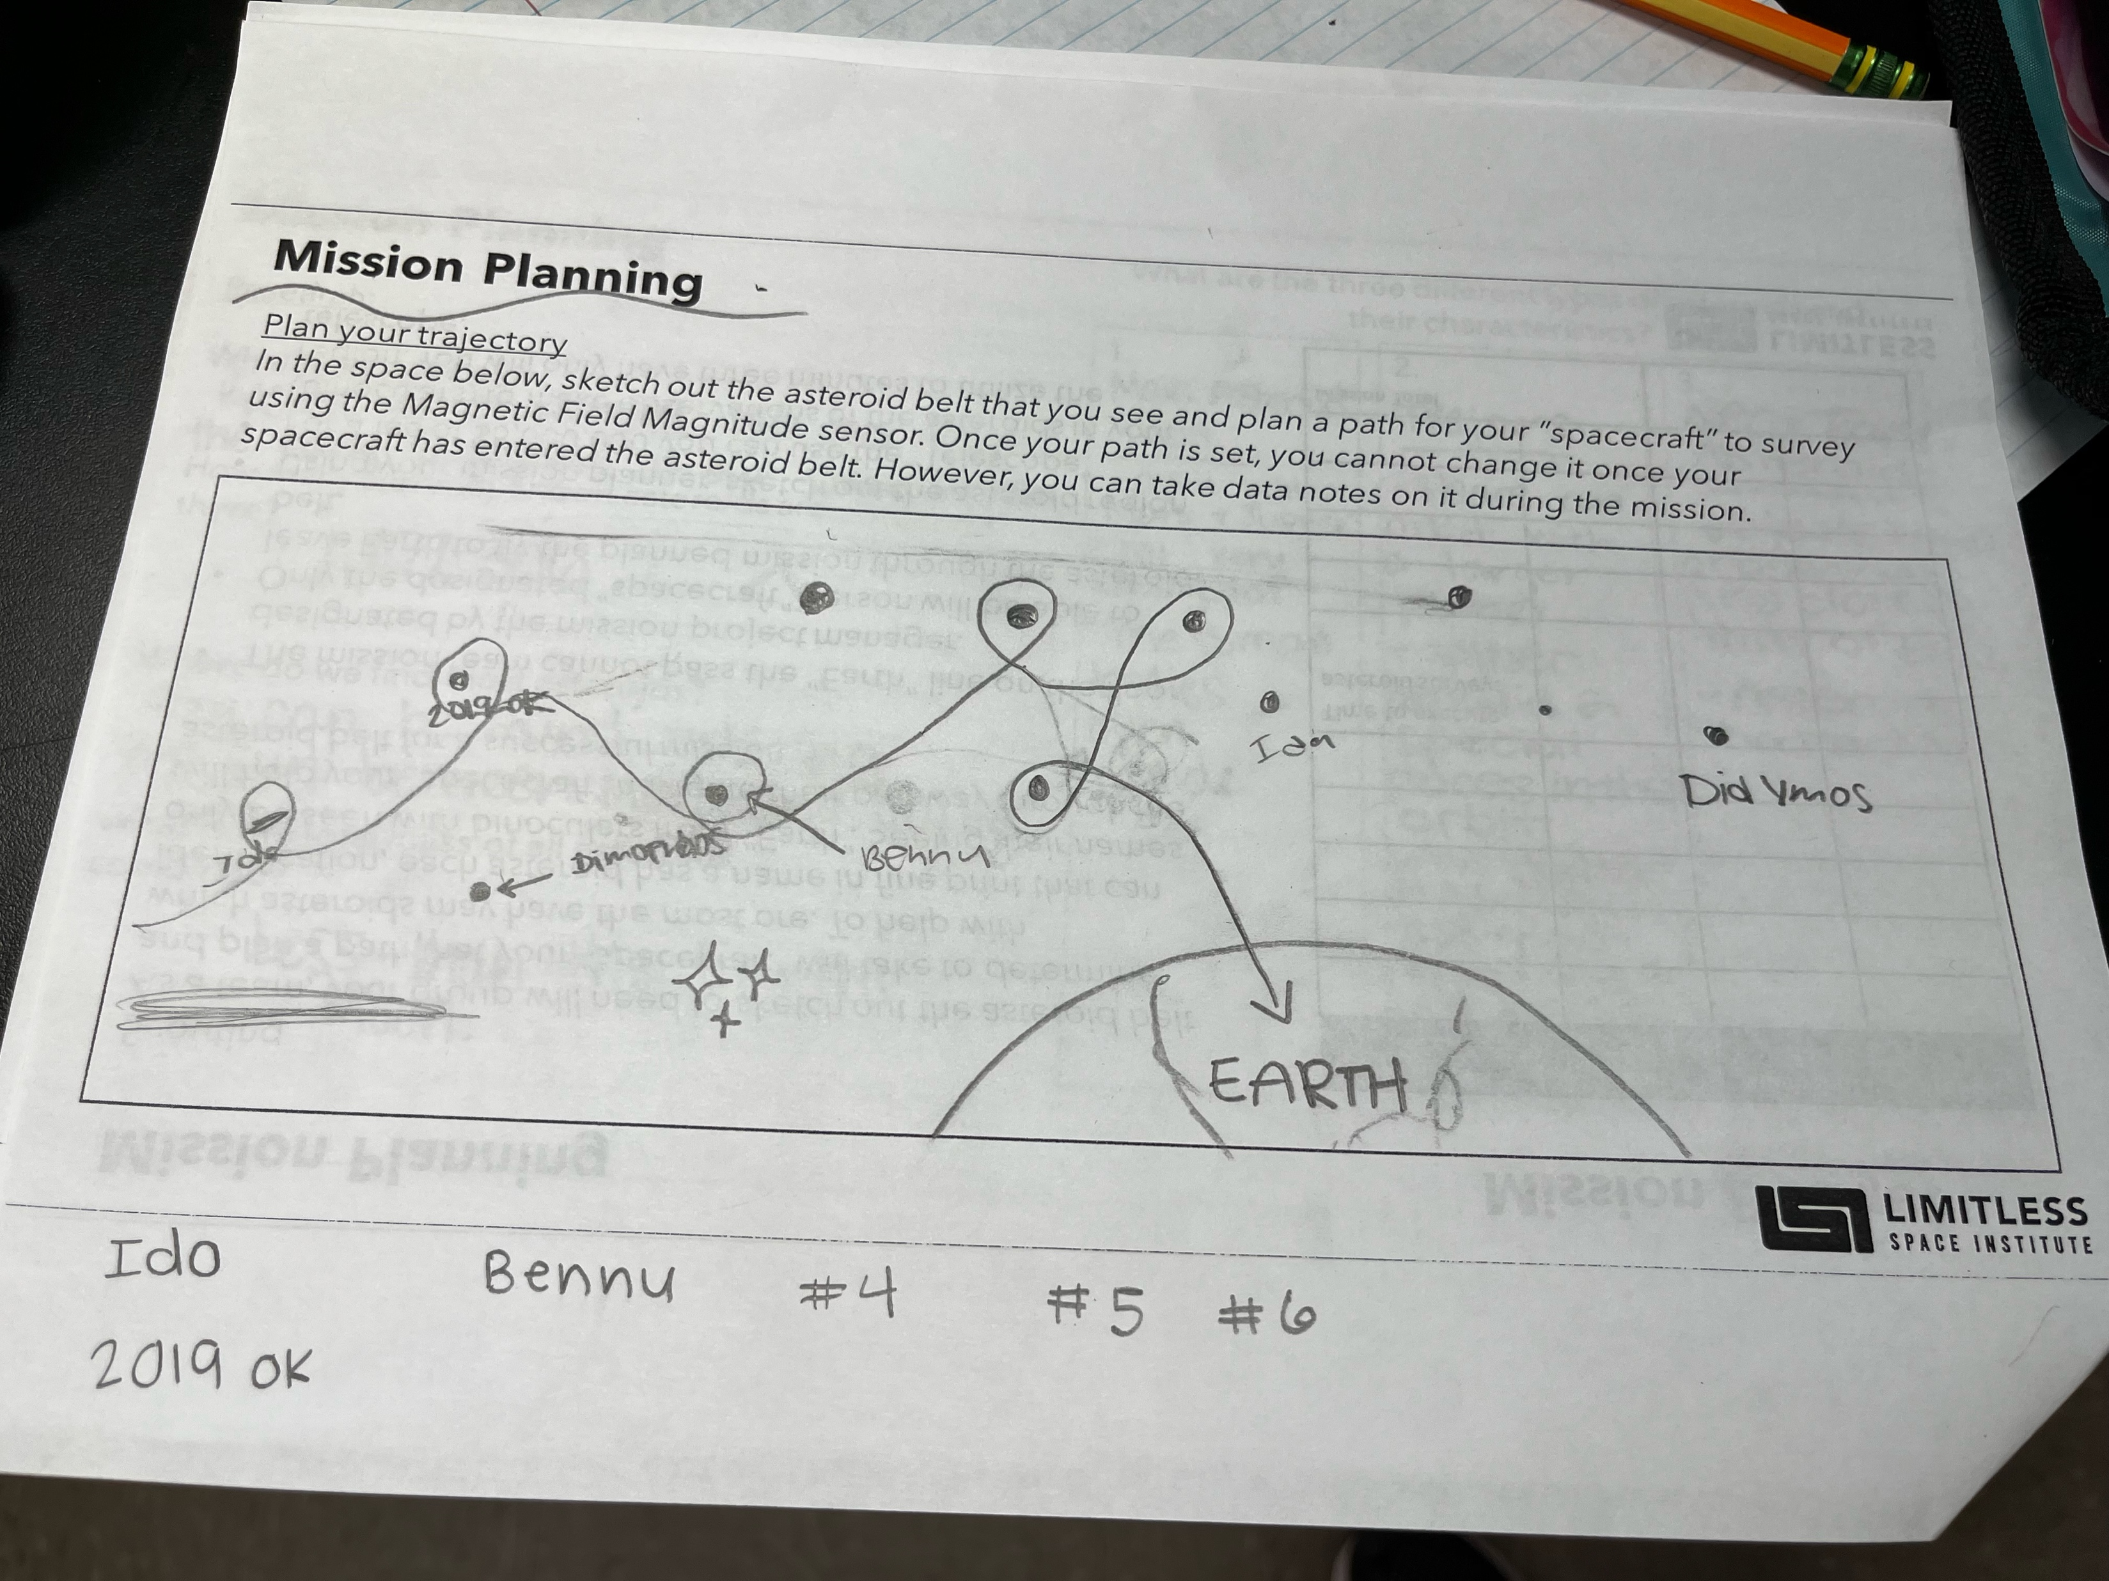
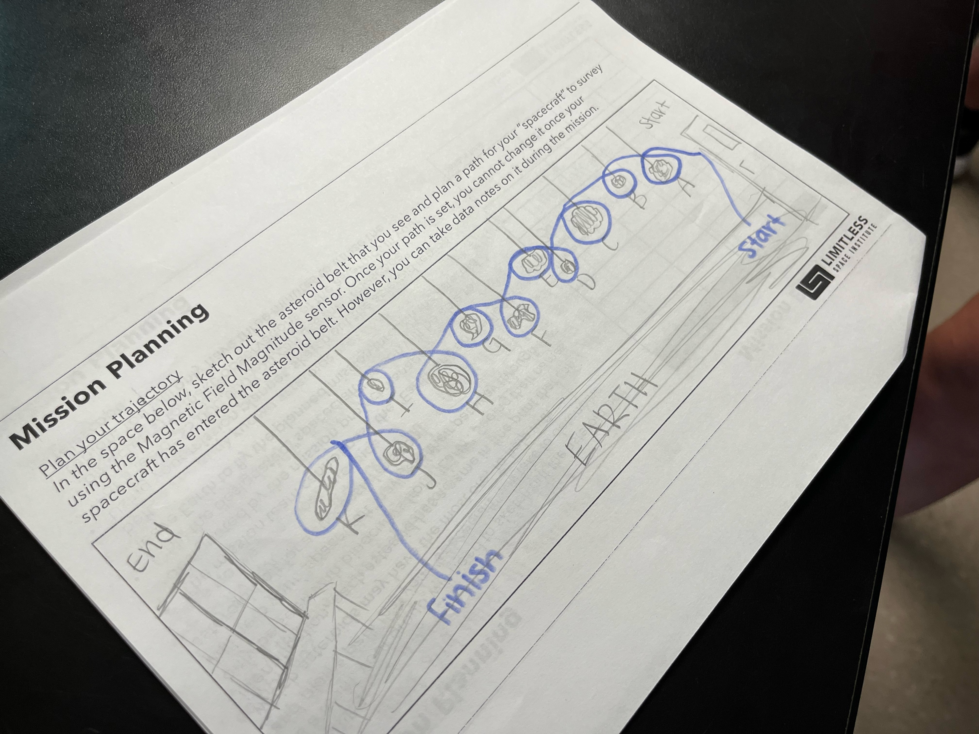
Mission Planning
Once the spacecraft is complete, students will need to identify which roles they would like for this mission. This is on the 3rd page of their packet.
The students will then need to plan out their path or trajectory through the asteroid field in order to identify which asteroids are metalloid and could have a large financial return.
A taped line should already be on the floor which represents “Earth”. Students cannot pass that line to explore the asteroid field.
Students must pay a ”fee” to use the binoculars or “telescope” for five minutes. Identifying the actual names of the asteroids will be incredibly helpful before the student that is carrying the spacecraft goes out on their mission.
Earth Line

Slide 28
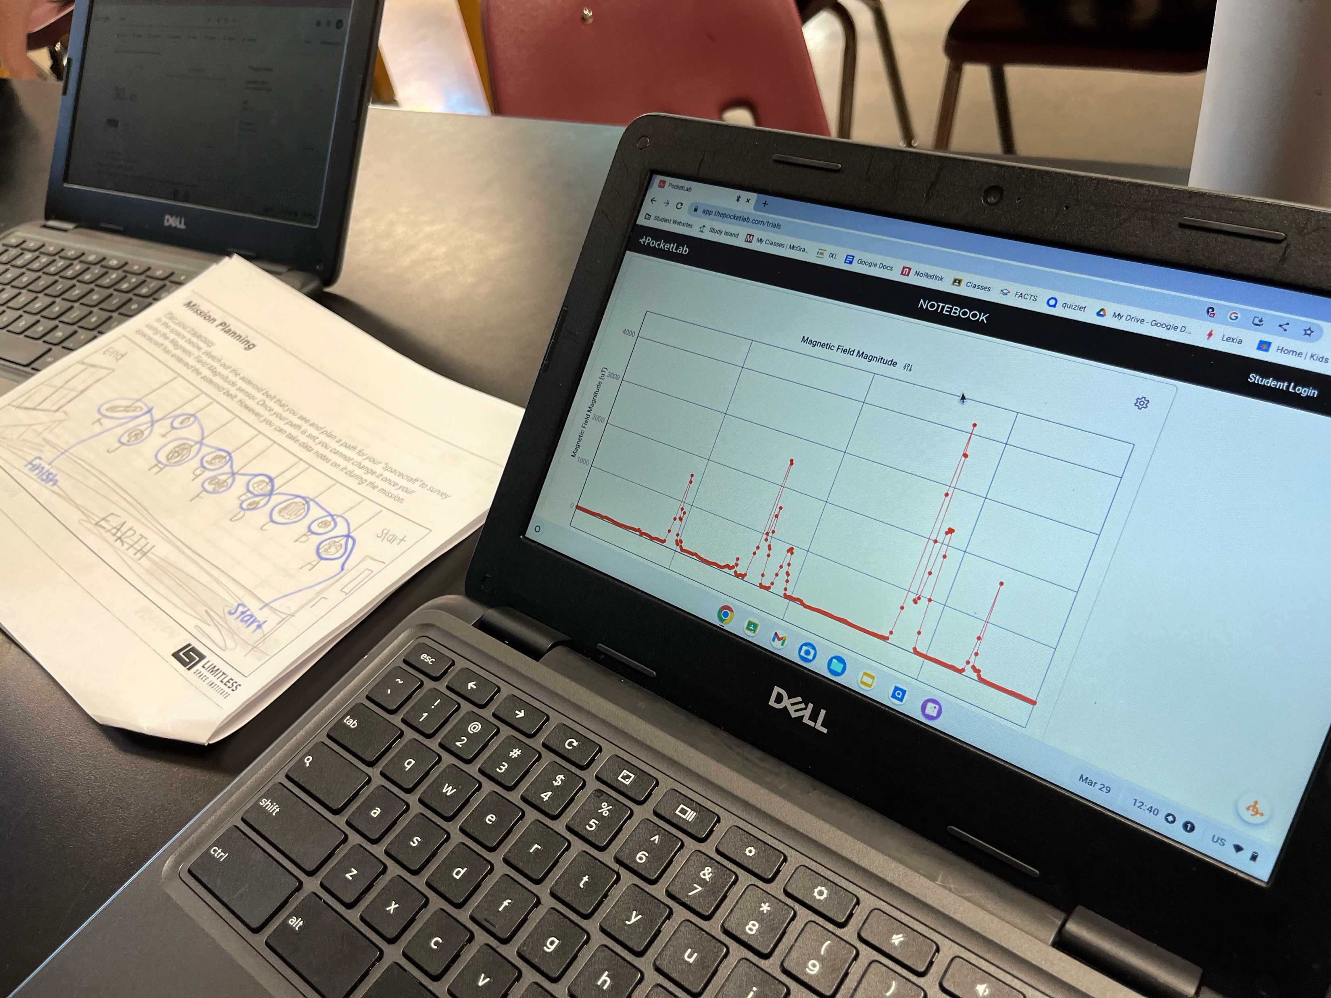
Mission Planning Continued
Once the trajectory has been planned, make sure students remember that this is a timed mission. Each second after they leave “Earth” is costing them money.
Have students run multiple tests, just like NASA, to ensure they have everything prepared for their mission.
The trick is that the time must correlate to the sensor data and identify what asteroid they are flying by at that specific time.
Students who are carrying the spacecraft can yell out the name of the asteroid when flying by and the timer can record this information on their trajectory sheet. This can later be correlated to the time stamp on the PocketLab data.
Students cannot run through the asteroid field. If they go too fast, they will not get good data. If they go too slow, it will cost them a significant amount of money.

Slide 29
Launch!
Once all the preparations have been made, the person who is taking the spacecraft through the asteroid belt needs to be on the line ready to “launch”.
The spacecraft cannot take their trajectory with them unless you allow it as the program manager. Mission control ususlly needs it. It is encouraged that the spacecraft student memorizes the trajectory.
The rest of the team is at “Mission Control” on “Earth”. Their computers need to be set up and ready to initiate data collection at the exact time that the student spacecraft leaves Earth and the timer begins.
A countdown may be appropriate (and fun) to ensure every job is executed at the same time.
As the project manager, you will need to make sure they don’t stray off of their trajectory. Feel free to apply fines if you notice they went in a different direction than planned.
The timer and data collection stops once they cross back across the line.
The students need to record how many seconds they were in flight and record that number on their budget sheet.

Slide 30
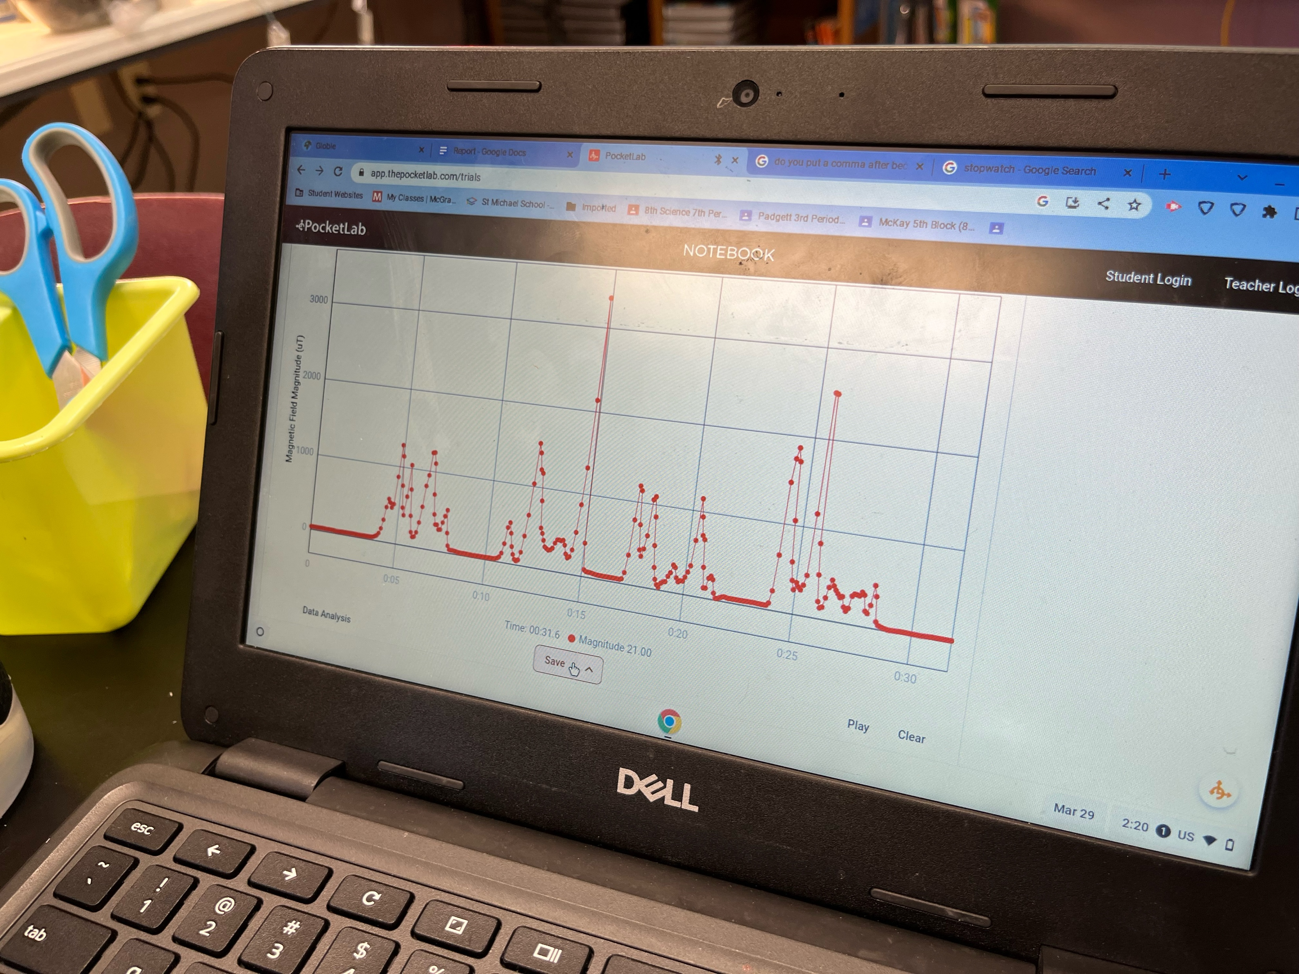
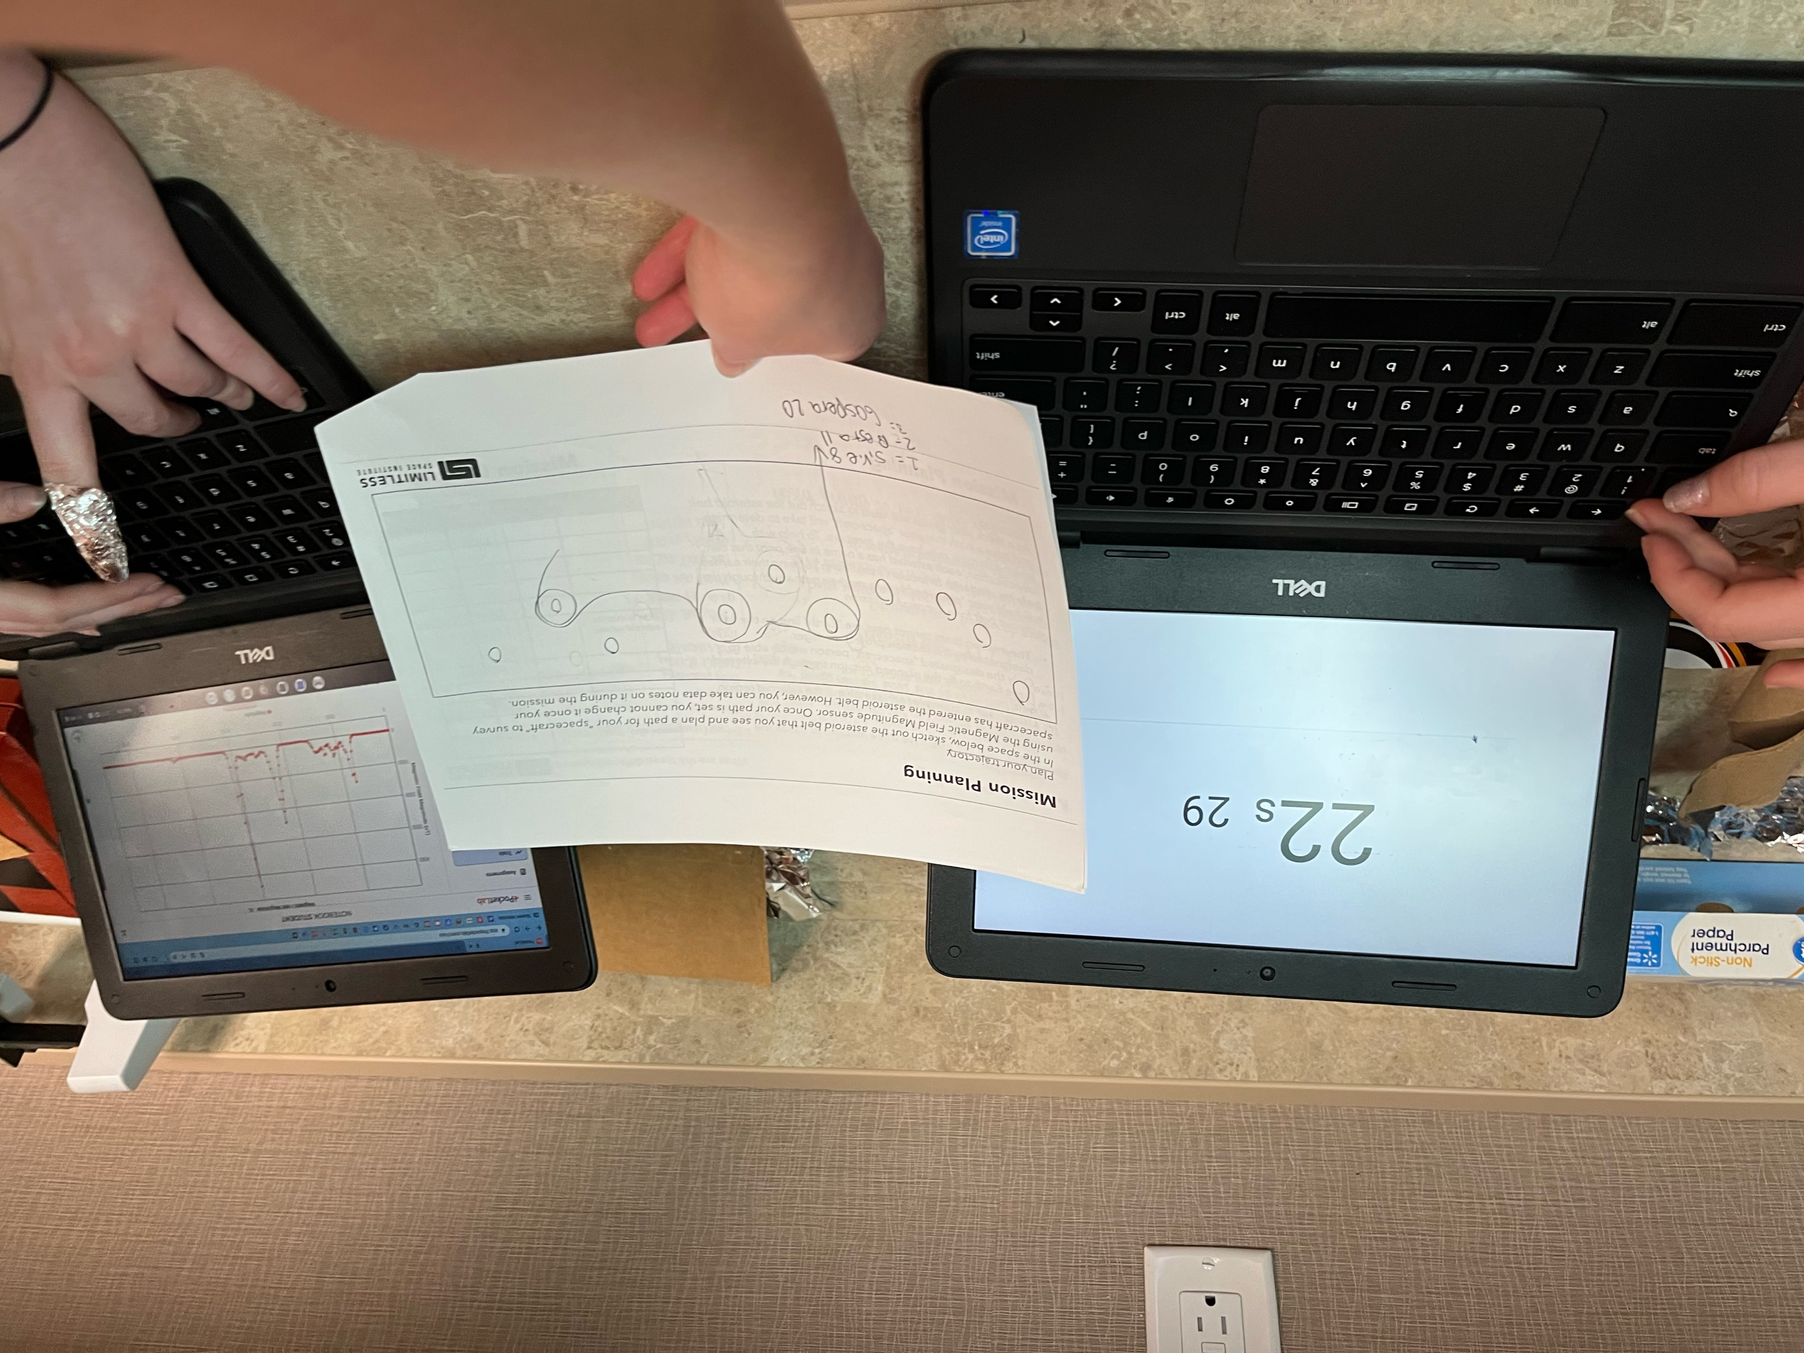
Analysis & Reporting
Once their flight is complete, students will need to work with their group to analyze the data to determine which asteroids had the strongest magnetic fields.
Students must justify in writing why they are selecting specific asteroids to mine. It is ideal to use claim, evidence, and reasoning for this section.
Once the students have made their predictions and reasoning, it now becomes the teacher’s responsibility to share out the true number of magnets in the various asteroids and how much the teacher identified that they would be worth.
After recording this information, the students must then complete their budgets and complete the mission report.
The mission report can be extended into a full project presentation if time allows.

Slide 31
NGSS Standards
Middle School
Elementary School
MS-PS2-2. Plan an investigation to provide evidence that the change in an object’s motion depends on the sum of the forces on the object and the mass of the object.
MS-PS3-5. Construct, use, and present arguments to support the claim that when the kinetic energy of an object changes, energy is transferred to or from the object.
MS-ESS1-3. Analyze and interpret data to determine scale properties of objects in the solar system.
MS-ETS1-1. Define the criteria and constraints of a design problem with sufficient precision to ensure a successful solution, taking into account relevant scientific principles and potential impacts on people and the natural environment that may limit possible solutions.
MS-ETS1-2. Evaluate competing design solutions using a systematic process to determine how well they meet the criteria and constraints of the problem.
MS-ETS1-3. Analyze data from tests to determine similarities and differences among several design solutions to identify the best characteristics of each that can be combined into a new solution to better meet the criteria for success.
MS-ETS1-4. Develop a model to generate data for iterative testing and modification of a proposed object, tool, or process such that an optimal design can be achieved.
4-PS3-1. Use evidence to construct an explanation relating the speed of an object to the energy of that object.
4-PS3-4. Apply scientific ideas to design, test, and refine a device that converts energy from one form to another.*
4-ESS3-1. Obtain and combine information to describe that energy and fuels are derived from natural resources and that their uses affect the environment.
5-PS1-1. Develop a model to describe that matter is made of particles too small to be seen.
3-5-ETS1-1. Define a simple design problem reflecting a need or a want that includes specified criteria for success and constraints on materials, time, or cost.
3-5-ETS1-2. Generate and compare multiple possible solutions to a problem based on how well each is likely to meet the criteria and constraints of the problem.
3-5-ETS1-3. Plan and carry out fair tests in which variables are controlled and failure points are considered to identify aspects of a model or prototype that can be improved.

Slide 32
Resources
https://solarsystem.nasa.gov/asteroids-comets-and-meteors/asteroids/overview/?page=0&per_page=40&order=name+asc&search=&condition_1=101%3Aparent_id&condition_2=asteroid%3Abody_type%3Ailike
https://www.lpi.usra.edu/education/explore/beyondEarth/activities/newPlanet.shtml
https://solarsystem.nasa.gov/asteroids-comets-and-meteors/asteroids/overview/?page=0&per_page=40&order=name+asc&search=&condition_1=101%3Aparent_id&condition_2=asteroid%3Abody_type%3Ailike
https://web.mit.edu/12.000/www/m2016/finalwebsite/solutions/asteroids.html
https://www.geekwire.com/2019/one-year-planetary-resources-faded-history-space-mining-retains-appeal/

